Slide 1
Memory

Slide 2
Memory
The memory is that part of the computer where programs and data are stored
Memories consist of a number of cells (or locations), each of which can store a piece of information
Each cell has a number, called its address, by which programs can refer to it
If a memory has n cells, they will have addresses 0 to n − 1
All cells in a memory contain the same number of bits

Slide 3
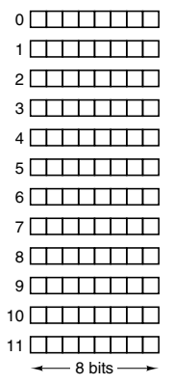
Memory Example

Slide 4
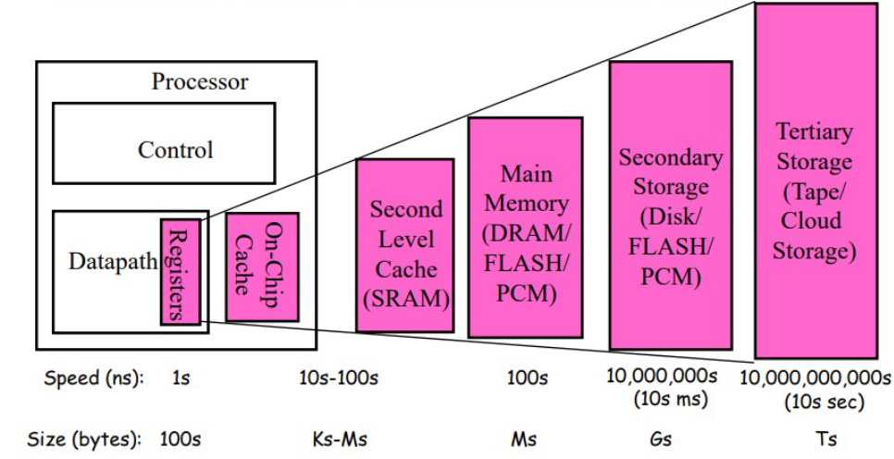
Use of Various Technologies

Slide 5
Technologies used in Memory Design
Types of memories
Random Access Memory (RAM): Memory from where data can be read and where data can be written – Volatile
Static RAM (SRAM)
Dynamic RAM (DRAM)
Read Only Memory (ROM): Memory from where data can be read, but not where data can be written
Useful for booting up, fixed data

Slide 6
Static RAM (SRAM)
Static RAM (SRAM) is constructed using flip-flops
Very fast - Access time is a nanosecond or less, so popular as cache memory
Consume more power
Volatile storage (no power, no storage)

Slide 7
Dynamic RAM (DRAM)
Dynamic RAM (DRAM) uses capacitors to store data
Requires periodic refreshing, unlike SRAM
Low cost, high capacity; so suitable as main memory (RAM)
Volatile storage (no power, no storage)

Slide 8
ROM
The data in a Read Only Memory (ROM) is inserted during its manufacture
The only way to change the program in a ROM is to replace the entire chip
Much cheaper than RAM
PROM (Programmable ROM) allows companies to write to the ROM chip once, not at the time of chip manufacturing
Example: A washing machine manufacturer can buy ROM chips and write its instructions on the chip

Slide 9
Auxiliary Storage
Auxiliary storage, also known as secondary memory or external storage, refers to the non-volatile storage devices that retain information even when the power supply is disconnected
Examples: HDD, SSD, Flash memory, Optical storage

Slide 10
Hard Disk Drive (HDD)
Mechanical storage devices
Use magnetic material to store data
High capacity, low cost
These days replaced by SSD

Slide 11
Flash Memory
Non-volatile memory
Retains data even when there is no power supply
Used in Solid State Drives (SSD), USB drives, memory cards
Low power consumption and durable
Other varieties: NAND flash memory or NOR flash memory

Slide 12
Solid State Drive (SSD)
Use NAND flash memory
Faster, more durable

Slide 13
Optical Storage
CD-ROM, DVD, Bluray disks
Magnetic disk contains information
Used more for music, movies, etc

Slide 14
Cache Memory

Slide 15
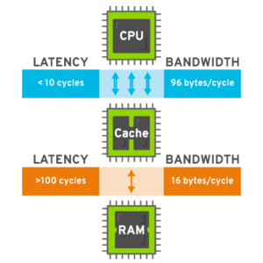
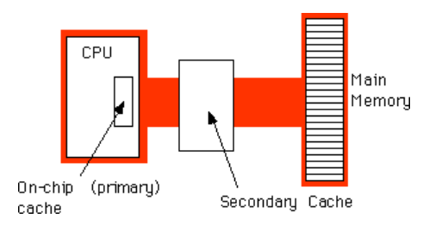
Cache Memory
Two-level cache

Slide 16
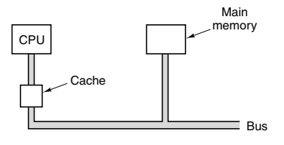
Cache Memory
CPU registers are limited in number (cost, CPU chip size are key factors)
More small, fast memory called cache memory is used (cacher: to hide in French, and pronounced ‘cash’)
The most heavily used memory words are copied in the cache – CPU first checks cache, if data is not in cache, it goes to main memory

Slide 17


Principle of Locality
A program accesses a relatively small portion of address space at any given time
Two types of principle of locality
Temporal locality (Locality in time): If some data is referenced, it will be referenced again soon
Spatial locality (Locality in space): If some data is referenced, data near it will also be referenced

Slide 18
Example
sum = 0;
for (i = 0; i < n; i++)
sum += a[i];
return sum;
Data
Temporal: Variable sum is referenced in each iteration
Spatial: array a[] is accessed
Instructions
Temporal: Cycle through the loop repeatedly
Spatial: Reference instructions in sequence

Slide 19
Hit Ratio, Miss Ratio
Hit Ratio (%) = (Number of Cache Hits / Total Memory Accesses) × 100%
Miss Ratio = 100% - Hit Ratio
Example: Suppose you have a cache system in a web server that receives 1,000 requests for web pages, and the cache is able to serve 800 of those requests from the cache (cache hits), while the remaining 200 requests had to be fetched from the main server (cache misses)
Hit Ratio = (800/1000) x 100 = 80% and Miss Ratio = 100% - 80% = 20%

Slide 20
Cache Optimizing Techniques
Cache size optimization: Increase cache size (but cost will increase)
Cache replacement policies: Least Recently Used (LRU), Most Recently Used (MRU), Random
Cache associativity: Mapping of cache lines to cache sets (Discussed separately)
Prefetching: Cache anticipates and fetches data before it is actually demanded
Write policies: Write-back (Write only in cache and update main memory only when necessary) or Write-through (Write to cache and to main memory)
Data locality: Repeated access to same instructions/data
Multi-level cache: L1 (Fastest) to L3 (Slowest) – See next slide

Slide 21
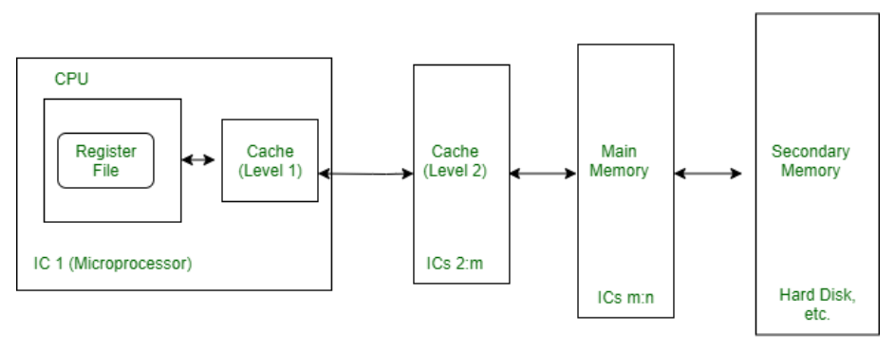
Cache Concept

Slide 22
Cache Associativity
Direct-mapped cache: One memory location -> One cache location
Set-associative cache: Deals with cache conflict
Fully associative cache: No mapping between memory location and cache location, any memory block can be stored anywhere in cache (Not discussed here)

Slide 23
Direct-Mapped Cache
Consider 16-bit memory addresses, 128 cache lines, and 32-byte cache blocks
A memory address is divided into three parts:
Tag: Identifies memory blocks’ location in the main memory
Index: Which set/slot in cache is used for which memory block?
Offset: Identifies a specific byte in cache
Example: Suppose our program now wants to read from memory location 1010000001100100

Slide 24
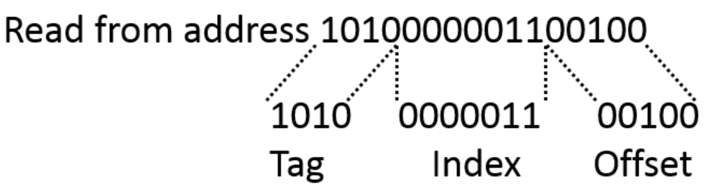
Direct-Mapped Cache
Example: Suppose our program now wants to read from memory location 1010000001100100 and cache is blank
This index binary value 0000011 i.e. 3 in decimal is used to lookup the cache

Slide 25
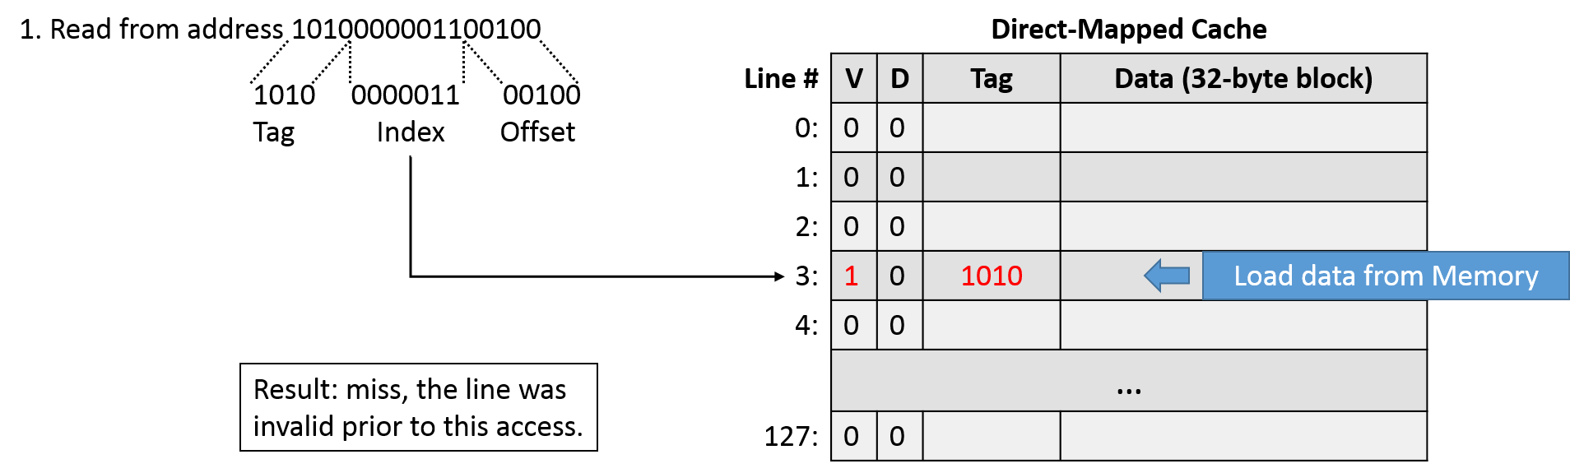
Direct-Mapped Cache
Since the cache line was empty, this was a cache miss. We need to go to main memory location 1010, get the 32-byte block from there, write in the cache at index 00000011, update the valid flag to 1 and return the 32-bit block to the program. Next time whenever anyone wants to read the 32-byte block at memory location 1010, we will have a cache hit.

Slide 26
Set-Associative Cache
Direct-mapped cache can cause cache conflict
Example: Suppose cache has 4 slots/sets (indexed with 2 bits) and main memory has 16 blocks (indexed with 4 bits)
With 2 bits for indexing, cache sets are 00, 01, 10, 11
But main memory has 16 blocks from 0000 to 1111
Result:
Memory block 0000 and memory block 0100 both map to set 00 in the cache
Memory block 0001 and memory block 0101 both map to set 01 in the cache
Memory block 0010 and memory block 0110 both map to set 10 in the cache
Memory block 0011 and memory block 0111 both map to set 11 in the cache
Which is correct, in each of the four cases? Solution: Set-associative cache

Slide 27
Set-Associative Cache: Both are Correct!
Memory block 0000 and memory block 0100 both map to set 00 in the cache
Memory block 0001 and memory block 0101 both map to set 01 in the cache
Memory block 0010 and memory block 0110 both map to set 10 in the cache
Memory block 0011 and memory block 0111 both map to set 11 in the cache
We now create two entries per cache set/slot to map both addresses
Cache set
00
01
10
11
LRU | V0 | D0 | Tag | Data | V1 | D1 | Tag | Data
0/1 |  |  | 0000 |  |  |  | 0100
0/1 |  |  | 0001 |  |  |  | 0101
0/1 |  |  | 0010 |  |  |  | 0110
0/1 |  |  | 0011 |  |  |  | 0111

Slide 28
Set-Associative Cache
Suppose our program now wants to read from memory block 0000
This will map to cache set 00 (but the first half), so if the valid bit is set, data will be read from there; else from actual memory block 0000, causing a cache miss
Next, suppose our program now wants to read from memory location 0100
Even this will map to cache set 00 (but the second half), so if the valid bit is set, data will be read from there; else from actual memory block 0100, causing a cache miss

Slide 29
Cache Coherence
In a multiprocessor/multicore system, multiple processors can access and modify shared data in the main memory
Each processor has its own cache for faster access
When one processor writes to a memory location, other processors might still have a copy of that data in their caches - This situation can lead to inconsistencies and data corruption if not managed properly
Cache coherence ensures the consistency and integrity of data stored in multiple caches in a multiprocessor or multicore system
Cache coherence protocols: MESI, MOESI, Write-through/Write-behind

Slide 30
MESI
MESI (Modified, Exclusive, Shared, and Invalid)
Tracks the state of each cache line (block) in a cache
When a processor modifies a cache line, it marks it as "Modified" and ensures that other caches invalidate their copies
When a cache line is read but not modified, it can be marked as "Shared" or "Exclusive" depending on whether other caches have copies

Slide 31
MOESI
MESI (Modified, Owner, Exclusive, Shared, and Invalid)
Same as before, with an addition
The "Owner" state is used to identify which cache has the exclusive right to modify a cache line
When a cache line is in the "Owner" state, other caches can read it but cannot modify it

Slide 32
Write-Through/Write-Behind Caches
Write-through caches: All writes are immediately written to main memory, ensuring that all processors see the updated data promptly
Write-behind caches: Delay writing updates to main memory, which can introduce complexities in maintaining coherence

Slide 33
Mechanisms to Enforce Cache Coherence Protocols
Invalidation: When one processor writes to a memory location, it sends an invalidation signal to other caches holding copies of that data, forcing them to invalidate their copies
Broadcast: Some protocols use broadcast messages to inform other caches of updates, ensuring that all caches are aware of changes to shared data
Snooping: Caches "snoop" or monitor memory transactions on the memory bus to detect and respond to changes in shared data

Slide 34
Using a Finite-State Machine to Control a Simple Cache
Using a Finite State Machine (FSM) to control a simple cache involves designing a set of states and transitions that manage cache operations
A cache FSM typically handles read and write operations, cache coherence, cache line replacement, and other control tasks
Defines states, inputs (events) and outputs (actions) using transition logic
States: Idle, Read, Write, Cache miss, Cache coherence
Inputs: External commands that change the state – Read, Write, Cache miss signal, Cache coherence signal
Outputs: Read requests to main memory, Updating of cache lines, Notifying the CPU of cache hits/misses, etc
Transition logic: Conditions under which state transitions can occur (Example: When a Read request is received, state might change from idle to read)

Slide 35
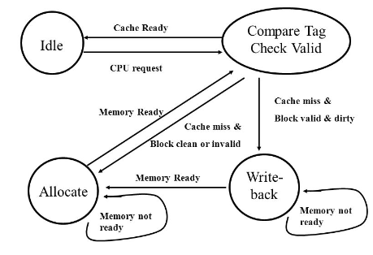
Sample FSM for Cache Operations

Slide 36
AMD Zen Memory and Intel Skylake Memory Hierarchy
L1 cache
L2 cache
L3 cache (Last cache)
Main memory (DRAM)

Slide 37
Memory Interleaving
Memory interleaving is a technique to improve memory access performance by distributing data across multiple memory modules or banks
Breaks up memory into smaller segments, or "interleaves," and distributes data evenly among them
For example, if we have two memory modules, the memory space might be divided into two interleaves: Interleave 0 and Interleave 1
When data is written to or read from memory, it is distributed across the interleaves in a round-robin fashion: For instance, the first data word goes to Interleave 0, the second to Interleave 1, the third to Interleave 0 again, and so on
Allows for parallel memory access because multiple interleaves or banks can be accessed simultaneously
More useful in multi-core processors where multiple processors may need to access memory concurrently

Slide 38







Memory Interleaving Example
Suppose we decide to use 4 interleaved memory modules
Module 0 will contain memory addresses 0, 4, 8, 12, 16, …
Module 1 will contain memory addresses 1, 5, 9, 13, 17, …
Module 2 will contain memory addresses 2, 6, 10, 14, 18, …
Module 3 will contain memory addresses 3, 7, 11, 15, 19, …
Advantage: The CPU(s) can read memory modules one after the other quickly to access data. For example, suppose an instruction needs data from memory locations 2 to 9. The CPU can quickly go to memory module 2, then to 3, then to 1, then to 2 again, etc.

Slide 39
Virtual memory – The need
Consider a computer that has actual physical memory of 4096 (2¹²) words, but 65536 (2¹⁶) memory addresses
Real memory locations: Addressable memory locations:
Binary | Decimal
000000000000 | 0
000000000001 | 1
000000000010 | 2
… | …
111111111111 | 4095
Binary | Decimal
0000000000000000 | 0
0000000000000001 | 1
0000000000000010 | 2
… | …
0000111111111111 | 4095
… | …
… | …
1111111111111111 | 65535

Slide 40
Explanation
Suppose we have a 16-bit computer
This means that the computer has 16 wires between the CPU and the main memory of the computer, i.e. Address bus is of 16 bits
So, the actual addressable addresses (2¹⁶) are 65,536
But suppose the main memory only has 4096 memory locations
Result: Memory addresses from 4096 to 65,535 are useless for us
See next slide

Slide 41
Main Memory and Addressable Memory
Memory address 65535
Memory address 65534
…
…
Memory address 4095
Memory address 0
Unusable addresses
Memory address 4095
Memory address 4094
…
…
…
Memory address 0
Physical memory
Addressable memory

Slide 42
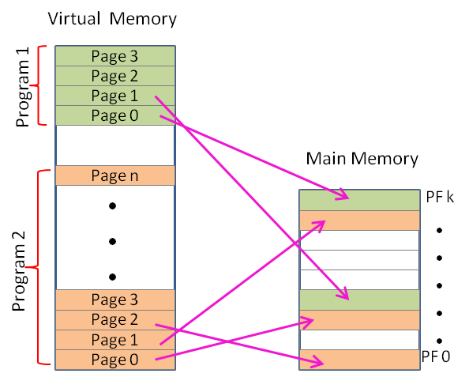
Virtual Memory Concept – Use of Secondary Storage

Slide 43
Virtual Memory – Benefits
In our example, a programmer can write a program, which assumes that there are 65,536 locations in the main memory, and not just 4096
In other words, the programmer can utilize the full 16-bit address space, when in reality there are only 4096 real memory locations
At a time, 4096 memory words would be loaded from virtual memory (i.e. secondary storage) into physical memory
If the program needs a word outside of these currently loaded words, a page fault occurs
The operating system will remove the current 4096 words from the physical memory and replace them with the needed words

Slide 44
Page Replacement algorithms to Handle Page Faults
Least Recently Used (LRU) algorithm: Evicts the page least recently used because of the probability of its not being in the current working set is high
First In First Out (FIFO): Removes the least recently loaded page, independent of when this page was last referenced. Associated with each page frame is a counter. Initially, all the counters are set to 0. After each page fault has been handled, the counter for each page presently in memory is increased by one, and the counter for the page just brought in is set to 0. When it becomes necessary to choose a page to remove, the page whose counter is highest is chosen.

Slide 45
Terminology
The addresses that the program can refer to are in the virtual address space, and the actual, hardwired (physical) memory locations are in the physical address space
A memory map or page table specifies for each virtual address what the corresponding physical address is
For this, both the virtual memory and physical memory is divided into equal-sized pages

Slide 46
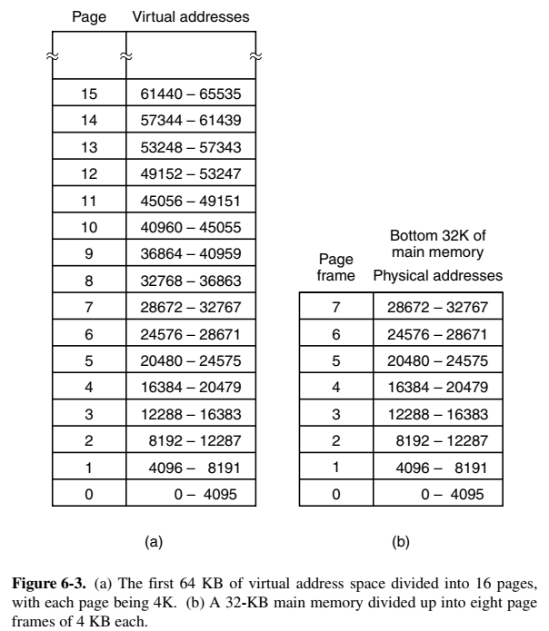
Divide Virtual Memory into Pages and Physical Memory into Page Frames
Physical memory
Virtual memory

Slide 47
Thrashing concept
A program that generates page faults frequently and continuously is said to be thrashing
Needless to say, thrashing is an undesirable characteristic

Slide 48
Associative Memory
Associative memory, often called as Content-Addressable Memory (CAM) or associative storage, is a type of computer memory that allows data to be retrieved based on its content rather than its specific memory address
Tags/keys are identified for search keywords/patterns and stored with the data
We search for content or pattern, instead of providing memory address
Parallel search is possible, leading to high performance
No need to sequentially look up memory addresses, so fast
Used in cache memory, network routers and applications where fast search is needed

Slide 49
An Overview of Latest Processors

Slide 50
Intel 32-bit and 64-bit Processors
Point | 32-bit processor | 64-bit processor
Architecture | X86 family, works with data and instructions that are 32-bit long | X86-64 or AMD64 family, works with data and instructions that are 64-bit long
Memory addressing | 2^32 i.e. 4GB memory addresses can be accessed | 2^64 i.e. 18.4 million TB memory addresses can be accessed
Software compatibility | Compatible with 32-bit and 16-bit software | Compatible with 64-bit and 32-bit software
Performance | Struggle with memory-intensive applications | Suitable for memory-intensive applications using multi-core
Limitations | 4GB RAM, Handling large data sets is slow | None at the moment

Slide 51
Generations of Intel Core Processors
Generation | Year | Brand names
First (Nehalem) | 2008 | Core i7, Core i5, Core i3
Second (Sandy Bridge) | 2011 | Intel Quick Sync Video
Third (Ivy Bridge) | 2012 | -
Fourth (Haswell) | 2013 | -
Fifth (Broadwell) | 2014 | -
Sixth (Skylake) | 2015 | -
Seventh (Kaby Lake) | 2016 | -
Eighth (Coffee Lake) | 2017 | More cores and threads in existing processors
Ninth (Coffee Lake Refresh) | 2018 | -
Tenth (Comet Lake and Ice Lake) | 2019 | -
Eleventh (Tiger Lake) | 2020 | -

Slide 52
HPC Processors: AMD, POWER, ARM
AMD, with its x86-based processors, has a significant presence in HPC, particularly in the consumer and mid-range server segments
AMD's EPYC processors have gained popularity in HPC clusters due to their competitive performance, memory bandwidth, and core counts
Key features include support for PCIe 4.0 for high-speed I/O and excellent floating-point performance
AMD's Infinity Fabric interconnect architecture allows for scalable multi-socket systems, making it suitable for a variety of HPC workloads
AMD's partnership with Cray (now part of HPE) has resulted in the development of powerful supercomputers like "Frontier" and "El Capitan"

Slide 53
HPC Processors: AMD, POWER, ARM
IBM POWER architecture is known for its high-performance computing capabilities and is used in some of the world's most powerful supercomputers
POWER processors are characterized by high core counts, significant memory bandwidth, and advanced vector processing units
IBM's Summit supercomputer, located at Oak Ridge National Laboratory, is one of the most prominent examples of POWER-based HPC systems - It was, at one point, the world's fastest supercomputer
IBM's involvement in the OpenPOWER Consortium has led to the availability of open-source hardware designs and increased adoption of POWER-based systems in HPC

Slide 54
HPC Processors: AMD, POWER, ARM
ARM processors, initially designed for mobile devices, are gaining traction in HPC due to their power efficiency and scalability
ARM-based processors, such as those from vendors like Cavium (now Marvell) and Fujitsu, are being used in HPC systems
ARM's approach to heterogeneous computing, with big.LITTLE configurations and accelerators, is well-suited for workloads that require both high performance and energy efficiency
ARM processors are often used in conjunction with GPUs or accelerators, allowing for balanced HPC systems
The ARM ecosystem's flexibility enables customized processor designs for specific HPC applications and research needs
Notable HPC Systems:
The "Fugaku" supercomputer, developed by RIKEN and Fujitsu, is currently the world's fastest supercomputer and is powered by ARM-based processors
Other ARM-based HPC systems, like the "Astra" supercomputer at Sandia National Laboratories, demonstrate the architecture's viability in the HPC space

